Slide 1
Use a new slide for your diagrams

Slide 2
Deliverable #2
Mbed code
Input: Click
Sensor Readings
Output: Formatted
String for Text File
Bluetooth or
USB
Connection
Deliverable #3
Click
Click
Interface
PCB
FRDM-KL46Z
Analytics Display
Click
Click
Output: Sensor
Reading
Output: Text File
Deliverable #1
Alfonso:
General Project Scope

Slide 3
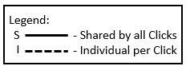
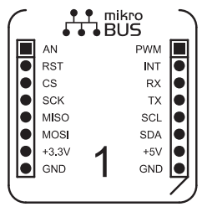
I
I
I
I
I
I
S
I
S
S
S
S
S
S
S
S
Legend:
- Shared by all Clicks
- Individual per Click
S
I
Alfonso:
PCB Layout #1

Slide 4
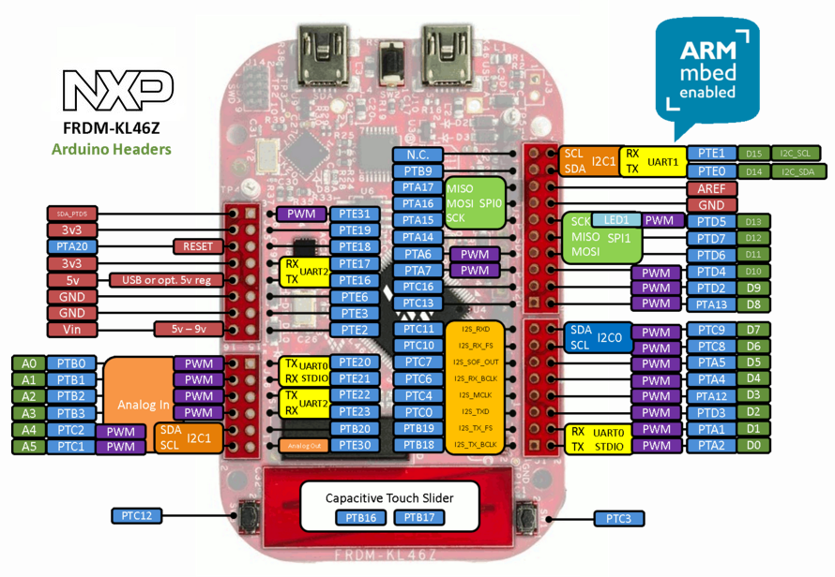
Alfonso:
PCB Layout #2

Slide 5
Verified
KL46Z stores Click Sensor reading
Serial
Click Sensor sends reading
PWM
KL46Z verifies input (as defined in Mbed code)
Store
Text file in host computer
(File size < 1GB)
IIC
SPI
Invalid
KL46Z stores invalid reading string
Access
Missing
Analytics or Web Display
Alfonso:
Use Case Error #1

Slide 6
Serial
Click has power
KL46Z has power
Click
PWM
IIC
SPI
Signal received
Data Base has power
Data base
Signal stored
Signal sent
KL46Z
Alfonso:
Use Case Error #1

Slide 7
Alfonso:
Logo

Slide 9
SPI: Serial Peripheral Interface
separate clock and data lines, along with a select line to choose the device you wish to talk to.
Master
Slave
CSCK
CSCK
MOSI
MOSI
FRDM KL46Z
MISO
MISO
Click
SS
SS
GND

Slide 10
The SPI devices disconnect their MISO pins when they are not selected
Each slave will need a separate SS line
SLAVE 1
SLAVE 2
SLAVE n
SCK
MOSI
MISO
SS
SCK
MOSI
MISO
SS
SCK
MOSI
MISO
SS
Master
SCK
MOSI
MISO
SS _ 1
SS _ 2
SS _ n

Slide 11
IIC
minimize number of pin and send more that 8 bits data
You can have up to 127 devices on a same bus
R1 and R2 are depended on slave and master voltage
Master
Slaves (n)
R1
Clock (SCL)
Data (SDA)
FRDM KL46Z
R2
Click

Slide 12
Slave 1
Slave 1
Slave n
CLICK 1
CLICK 1
CLICK n
SCL SDA
SCL SDA
SCL SDA
Master
R1
Clock (SCL)
Data (SDA)
R2

Slide 13
UART

Slide 14
PWM

Slide 15
Compaire availabilty PIN

Slide 16
Solution

Slide 17
Schametic

Slide 18
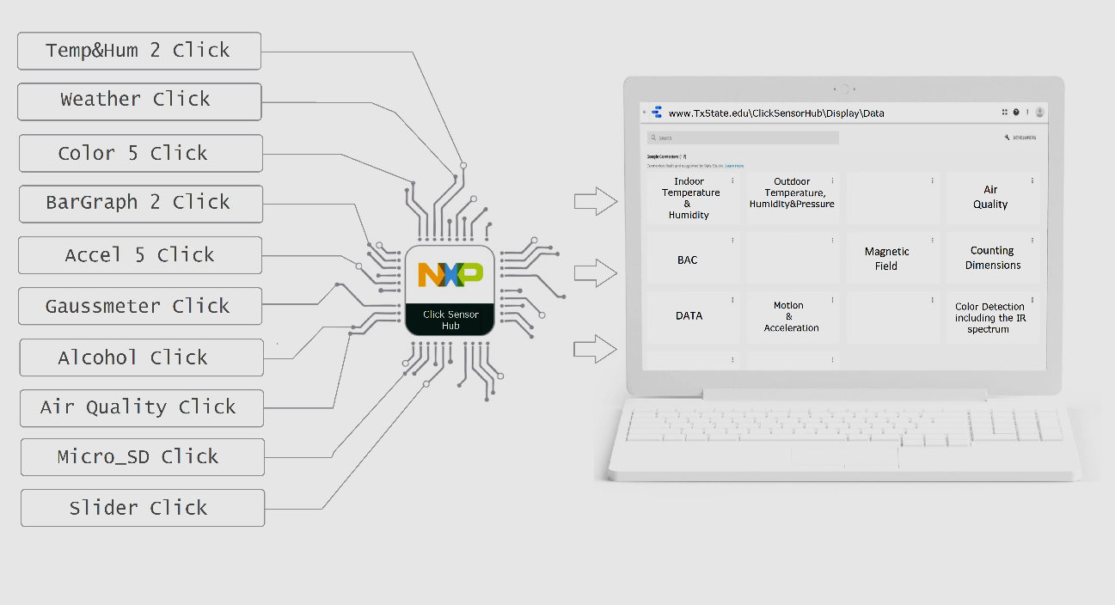
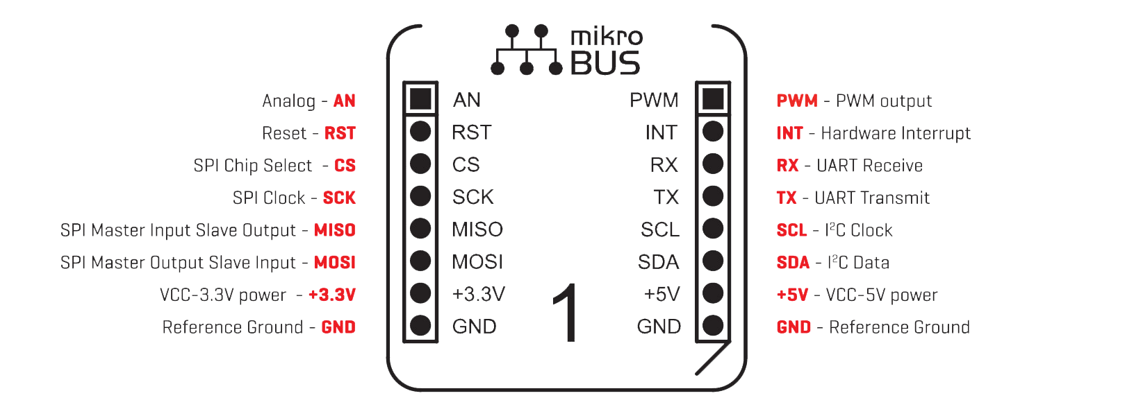

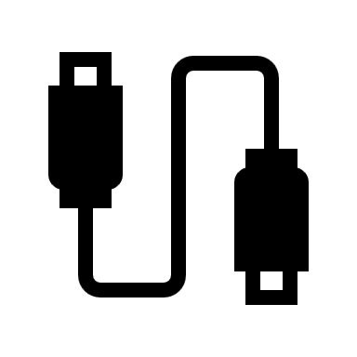
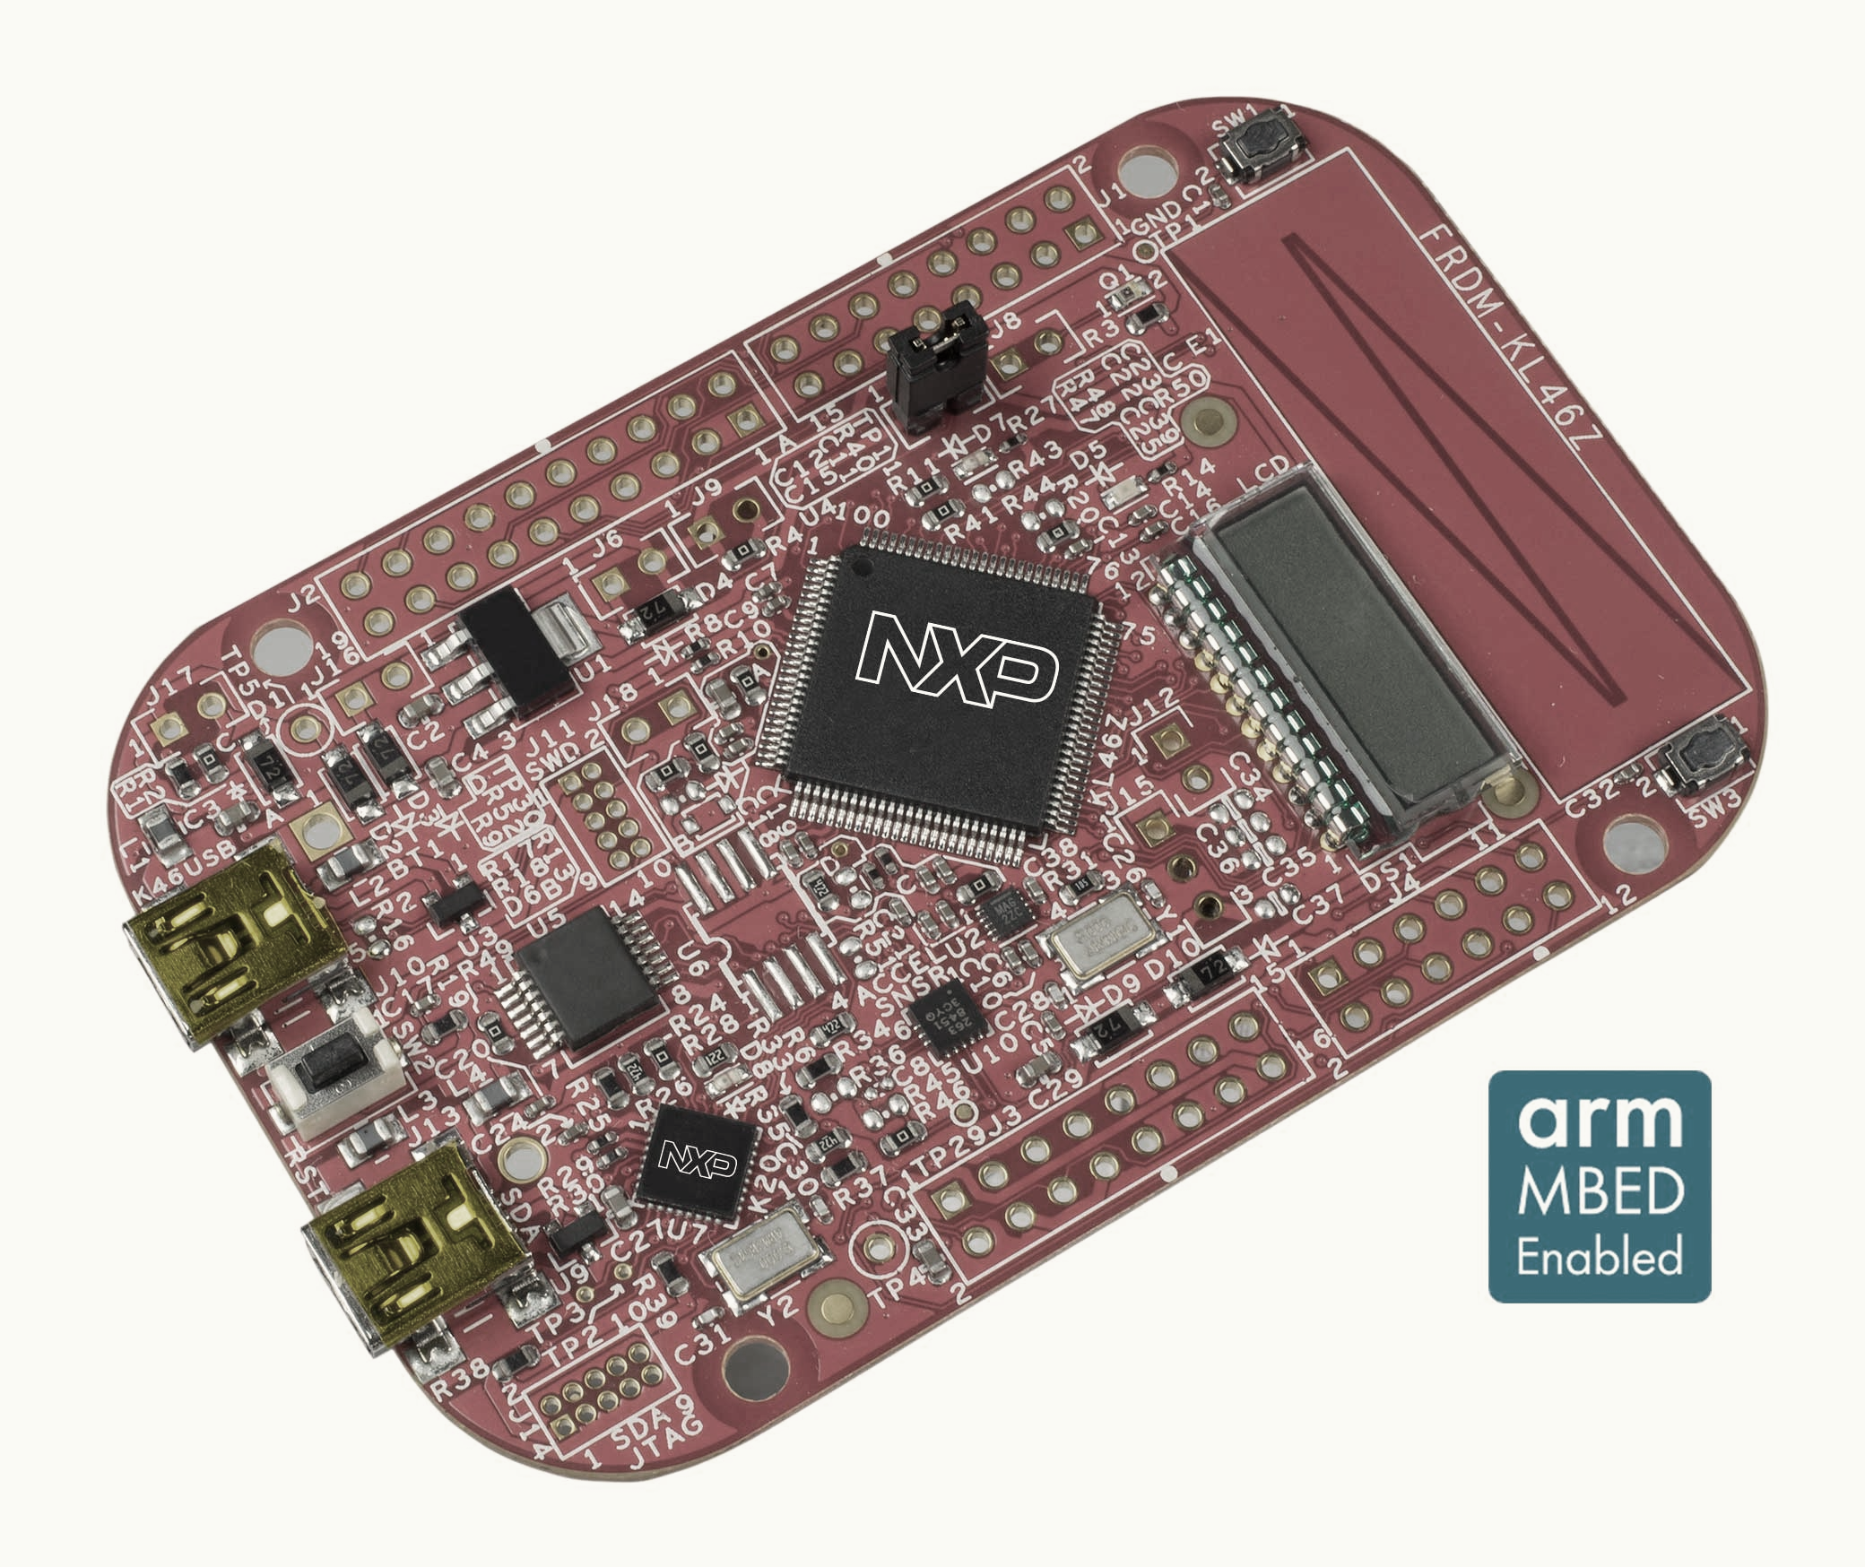


CHOOSE ANY FOUR
CLICK SENSOR HUB
1
2
3
4
HUB TO BOARD CONNECTION
FRDM-KL46Z
PC CONNECTIVITY
COMPUTER
Dylan:
Rough Design Layout
Notes:
I think it is misleading to show 10 Clicks connected to the hub… Perhaps show 4 connected and the other 6 off to the side?
In the center I would show your Click Sensor Hub connected to a FRDM board, and the FRDM board connected via USB or BT to the laptop.

